Slide 1
Infant Falls

Slide 2
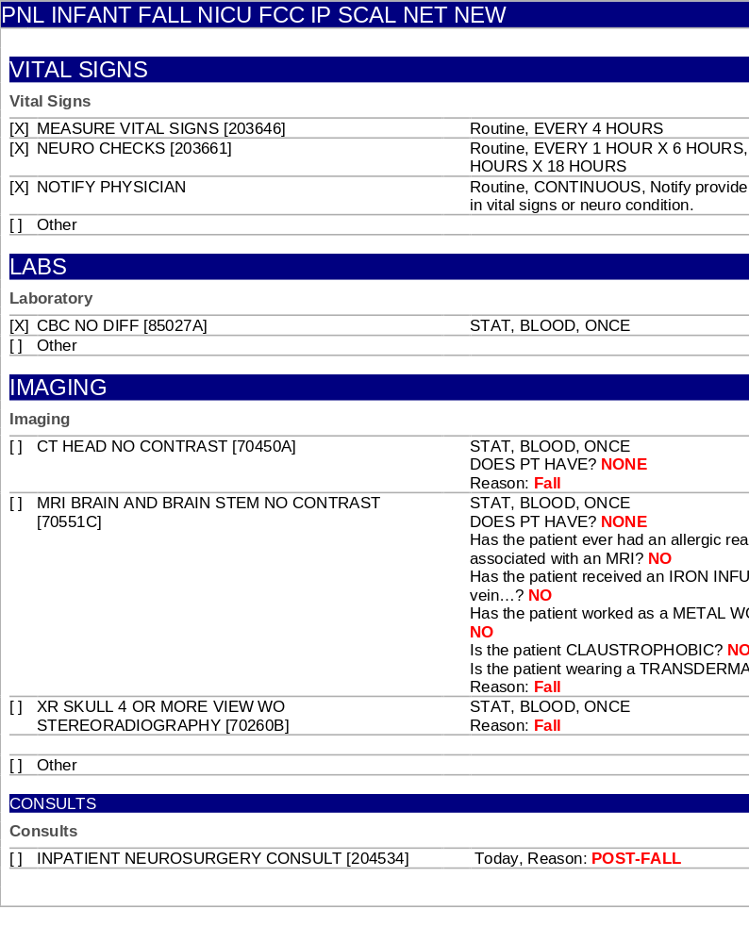
Order Panel

Slide 3
Recommendations for Infant Fall
-To standardize the process of evaluation and management of neonates who experience a fall or drop to the ground during hospitalization after birth.
-Upon discovery of an infant fall:
1. Transfer infant to the nursery radiant warmer and place pulse oximetry on baby to initiate monitoring.
2. Notify physician on call.
3. Admit to NICU for observation for minimum of 24 hours continuous cardiovascular monitoring.
Neurology:
Neurological check on admission, every 1 hour x 6 hours, then every 2 hours for 18 hours.
Significant abnormal physical exam: STAT CT Scan, neuro consult
Less severe cases, MRI can be attempted in lieu of CT scan to avoid radiation exposure. MRI to be completed within 24 hours.
Consider skeletal x-rays and head ultrasound.
Nutrition/ IV fluids:
Po feeding if normal neurological examination and vital signs.
If any alteration in vital signs or neurological exam, IV will be inserted and maintenance IV fluids will be started.
Blood works:
On admission: Type/Screen and Hb/Hct
Repeat Hb/Hct in 24 hours
Consults:
Neurology, Neurosurgical
Ophthalmology for retinal exam if concern for non-accidental trauma

